Slide 1
HUMAN REPRODUCTION –THE MIRACLE OF LIFE
Life Sciences

Slide 2
Life Sciences
Key Points: Human Reproduction
Fertilisation
Development of the Zygote
Role of Oestrogen and Progesterone
Diagram of a Developing Foetus
Functions of Structures of the Developing Foetus

Slide 3
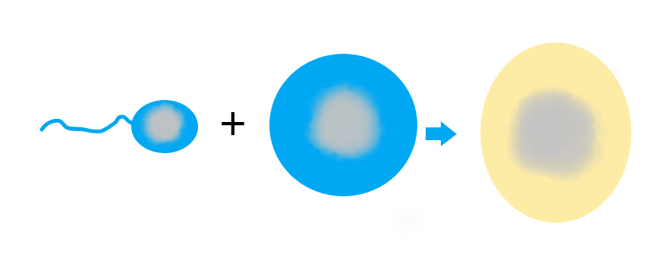
Life Sciences
Fertilisation
23 Chromosomes + 23 Chromosomes = 46 Chromosomes in Zygote (2n)

Slide 4
Life Sciences
Fertilisation
When the nuclei of a sperm cell and an ovum combine.
Each gamete contributes a set of chromosomes (n),
the result is a zygote (2n).

Slide 5
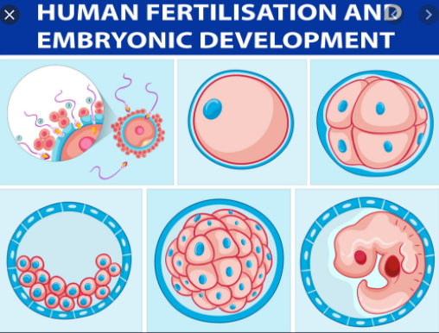
Life Sciences
Blastula and Blastocyst Embryo
From Vectorstock.com

Slide 6
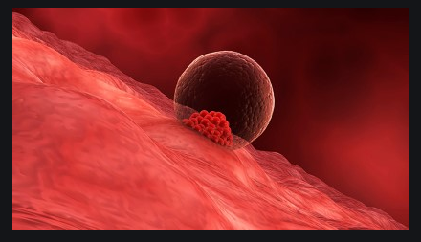
Life Sciences
Implantation

Slide 7
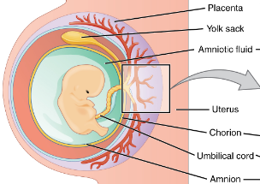
Life Sciences
Developing Foetus

Slide 8
Life Sciences
What are the following?
Chorion
Chorionic villi
Amnion
Umbilical cord
Placenta

Slide 9
Life Sciences
Developing Foetus

Slide 10
Life Sciences
What are the functions of the following?
Chorion
Chorionic villi
Amnion
Umbilical cord
Placenta

Slide 11
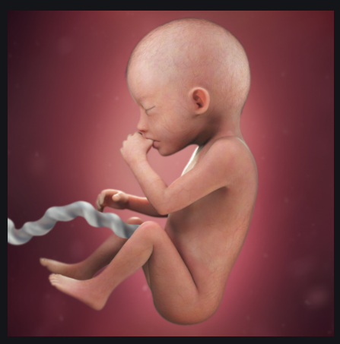
Life Sciences
Foetus at 20 Weeks

Slide 12
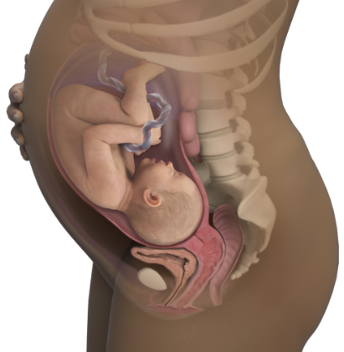
Life Sciences
Foetus at 36 weeks

Slide 13
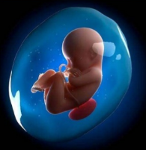
Life Sciences
Amniotic Fluid

Slide 14
Life Sciences
Functions of Amniotic Fluid
Prevents dehydration
Protects the foetus against physical injury, acting as a
shock absorber.
Prevents extreme temperature changes.

Slide 15
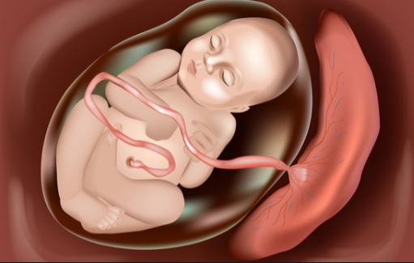
Life Sciences
The Placenta

Slide 16
Life Sciences
Functions of the Placenta
Gases exchange between mother and foetus.
Nutrients diffuse from mother’s blood to foetus.
Micro-filter to prevent viruses in mother’s blood to enter the foetus.
Allows antibodies from mother to foetus.
Produces Progesterone.

Slide 17
Life Sciences
The role of Oestrogen during Pregnancy
Causes the uterus to grow.
Triggers the development of the foetus’ organs.
Stimulates the development of the placenta.
Regulates other female hormones.

Slide 18
Life Sciences
The role of Progesterone during Pregnancy
Maintains the endometrium.
Causes an increase in blood flow to the uterus.
Prevents further ovulation during pregnancy.

Slide 19
Life Sciences
Key Points: Human Reproduction
Fertilisation
Development of the Zygote
Role of Oestrogen and Progesterone
Diagram of a Developing Foetus
Functions of Structures of the Developing Foetus

Slide 20

Life Sciences

